Slide 1
Data Encryption & Integrity: Innovations in Azure SQL
Pieter Vanhove
Program Manager
Microsoft

Slide 2

Agenda
Data confidentiality controls
Transparent Database Encryption
Always Encrypted
Data integrity controls
Ledger

Slide 3
Protecting Data Through its Lifecycle
EXISTING ENCRYPTION
Data at rest
Data in transit
Data in use
Encryption of data at rest stored in database files, backup files, log files
Transparent Database Encryption (TDE)
Encrypt data that is flowing between applications and the database
Transport Layer Security (TLS)
Encrypt data used during query processing
Always Encrypted

Slide 4
Transparent Data Encryption

Slide 5

The benefits of Transparent Data Encryption (TDE)
Protects data-at-rest
Entire database is encrypted on disk (not in memory)
Enabled by default
No application or schema changes are required
Backups, data, and log files are unusable without the encryption key
Supports both service-managed and customer-managed keys
Notes:
Transparent data encryption is a security feature that enables the encryption of your data at rest, so that only authorized users can access it. By using this feature, you can protect your data without modifying any of your applications. Transparent data encryption supports both service-managed keys and customer-managed keys. You can choose to use your own encryption keys created in Azure Key Vault or use service-managed keys that are supported by default for Azure SQL. With transparent data encryption, you can also enable cross-tenant key access and integrate with Azure Key Vault, which allows you to manage your keys and secrets in a secure and centralized location. Lastly, it uses the latest TLS 1.3 encryption technology to secure your data in transit, which can help you protect your data from attackers and internet service providers who might try to view or tamper with your data in transit.

Slide 6

Key Management
Customer-Managed
Key (CMK)
System-Managed Key (SMK)
TDE Protector
Encrypt
Database Encryption Key (DEK)
Decrypt
Encrypt
Azure SQL Database
Remote Storage - Encrypted
Azure SQL Data Protected by TDE
Local Storage- Not Encrypted
Azure SQL Data Protected by TDE
OR
Notes:
The Database Encryption Key (DEK) is encrypted using AES 256 algorithm.
The DEK is protected using TDE protector that encrypts the DEK
There are two TDE DEK protectors:
System-managed key (SMK) –also known as platform managed key
The protector uses built-in server certificate a unique for each server
The build-in certificate is automatically rotated (at least once a year)
Default for Azure SQL
Customer-managed key (CMK)
The protector uses a customer-managed asymmetric key
The key is stored in a customer-owned and managed Azure Key Vault (AKV)
Can be generated in ley vault or transferred for from vault to HSM device
Such key never leaves the AKV
TDE encryption can be disabled
For Azure SQL Database and Azure Synapse, the TDE protector is set at the server level and is inherited by all databases associated with that server.
Remote storage is used by Editions: Basic – Standard – General Purpose and Hyperscale
Local Storage is used by Premium and Business Critical and is not encrypted.
With remote storage you get double encryption of your data.
With local storage the data is only encrypted with TDE. Which means that if you disable TDE on a Premium or BC DB that your data is NOT encrypted. We strongly recommend to always use TDE.

Slide 7

TDE - Customer Managed Key
Server level configuration using the same encryption key for all databases
Database level configuration using encryption keys setup for individual databases
Automated key rotation that follows Azure Key Vault key rotation policy
Cross-tenant key access using Azure Key Vault in the customer tenant different than the database tenant
CMK configuration options
Azure SQL DB
ISV - Best Services Tenant
Customer- Contoso Tenant
DB 1
UMI 1, Key 1
Server level CMK Key 1
Server level UMI 1
Key Vault 1
Key 1
Key Vault 2 Key 2
DB 2
UMI 2, Key 2
Database level CMK Key 2
Muti-tenant app and UMI 2

Slide 8
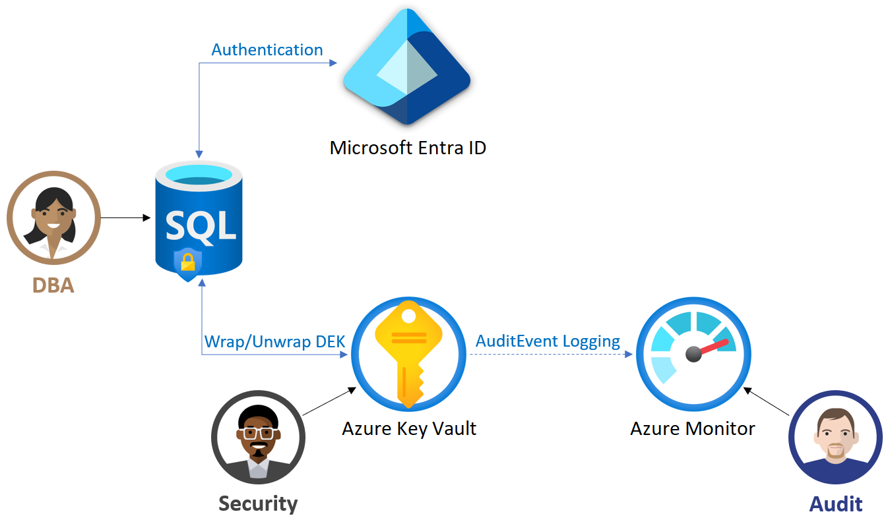
Customer-managed Key (CMK)
The customer is responsible and in full control of the key
Asymmetric key stored in Azure Key Vault
Supported key lengths are 2048, 3072 and 4096 bits
Activation date set in the past – Expiration date in the future
Enabled state
Requires managed identity for the Azure SQL with following access
get - to retrieve the public part and properties of the key in the Key Vault
wrapKey - to encrypt DEK
unwrapKey - to decrypt DEK
Notes:
In order for the logical server in Azure to use the TDE protector stored in AKV for encryption of the DEK, the key vault administrator needs to give the following access rights to the server using its unique Microsoft Entra identity:
get - for retrieving the public part and properties of the key in the Key Vault
wrapKey - to be able to protect (encrypt) DEK
unwrapKey - to be able to unprotect (decrypt) DEK
Key vault administrator can also enable logging of key vault audit events, so they can be audited later.
When server is configured to use a TDE protector from AKV, the server sends the DEK of each TDE-enabled database to the key vault for encryption. Key vault returns the encrypted DEK, which is then stored in the user database.
When needed, server sends protected DEK to the key vault for decryption.
Auditors can use Azure Monitor to review key vault AuditEvent logs, if logging is enabled.

Slide 9

Database level CMK
Independent from TDE setup at the server level
Automated key-rotation
Same AKV permissions are required like server-level CMK
Requires User-Managed Identity
Supports cross-tenant AKV keys
Primary customers: ISVs using Elastic Pools offering customers their own CMKs created in customer’s tenants
GA last September

Slide 10
Cross-tenant support for Database-level CMK
ISV - Best Services Tenant
Customer- Contoso Tenant
Key Vault 1 Key 1
Key Vault 2 Key 2
Server level CMK Key 1
Server level UMI 1
Azure SQL server
DB 1
UMI 1, Key 1
Database level CMK Key 2
Muti-tenant app and UMI 2
DB 2
UMI 2, Key 2
Multi-tenant App
Multi-tenant App
Registered
Database level UMI 2
Notes:
The diagram below summarizes the new functionality indicated above. It presents two separate Microsoft Entra tenants. The Best Services tenant that contains the Azure SQL logical server with two databases, DB 1 and DB 2, and the Azure Key Vault 1 with a Key 1 accessing the database DB 1 using UMI 1. Both UMI 1 and Key 1 represent the server level setting. By default, all databases created initially on this server inherit this setting for TDE with CMK. The Contoso tenant represents a client tenant that contains Azure Key Vault 2 with a Key 2 assessing the database DB 2 across the tenant as part of the database level CMK cross-tenant support using Key 2 and UMI 2 setup for this database.

Slide 11
Demo: Database level CMK Support for Azure SQL Database
Notes:
View the Azure Key Vault setting with CMKs being used
View the CMK setting at the server level
Demo the steps to create a databases using database-level CMK
View the newly created database with database-level CMK

Slide 12
Always Encrypted

Slide 13


Motivation
Enable customers to confidently store their most sensitive data in the cloud
Customers can stay in control of their data
Protect sensitive data in use from high-privileged yet unauthorized users
Traditional access control (SQL permissions, RBAC) and encryption technologies (TDE/TLS) are insufficient
Third-party client-side encryption solutions make it impossible to query and process the protected data in the cloud
Support confidential computations
Query processing without exposing data to admins
Database system can process queries
Query
Results
Application
Cloud operators
Other tenants, malware, hackers
DBAs and cloud resource admins in customer’s org
Notes:
TDE and TLS do not protect the data from rogue DBAs who can run arbitrary queries against the database to easily retrieve any data they want. OS administrators can also exfiltrate the data, for example by extracting it from the memory of the SQL Server process.
The goal of encryption in use is to ensure that privileged but unauthorized users of the database system - admins, hackers and malware - can’t access the data (at least not in plaintext).
At the same time, we want to ensure the database system remains useful and can process queries while the data is protected. We call this vision confidential computation.
One approach for confidential computing involves using special encryption algorithms that make it possible for the database system to process queries without ever decrypting data/

Slide 14
Always Encrypted
SQL Server 2016 and later, Azure SQL Database/Managed Instance
Cosmos DB
Protects data in-use from malicious DBAs, OS admins, and malware
plaintext
ciphertext
Database Client
SQL Client Driver
Database Engine
Client-side encryption
Client-side encryption of sensitive data using keys that are never given to the database system
Encryption transparency
Client driver transparently encrypts query parameters and decrypts encrypted results
Confidential equality comparisons
Point lookup searches, equality joins, grouping via deterministic encryption
Notes:
We started a journey towards the confidential computing vision in 2015 and we released the initial version of Always Encrypted.
Always Encrypted (it’s original version) is a client-side encryption technology: the data gets encrypted on the client side (within the client driver) before being stored in the database. The data is never decrypted inside the database. This provides strong, but computations on protected data is restricted to just one operation – equality comparison, which is supported via deterministic encryption.
Anna at end: OK this is pretty advanced technology. But, if we can only do equality comparison, is that going to be a bit limiting?

Slide 15
Always Encrypted with secure enclaves
SQL Server 2019 and later, Azure SQL Database
ciphertext
plaintext
ciphertext
Secure Enclave
ES DLL
Database Client
SQL Client Driver
plaintext
Database Engine
Secure computations inside the enclave
Database Engine delegates operations on encrypted data to the enclave, where the data can be safely decrypted and processed
Rich queries
Pattern matching (LIKE), range queries (<, >, etc.), sorting, indexing
In-place encryption
The enclave can perform initial data encryption and key rotation without moving the data out of the database
Notes:
Now, we are expanding the capabilities of Always Encrypted with a technology called secure enclaves.
When processing SQL queries, the database engine delegates computations on encrypted data to a secure enclave. The enclave decrypts the data and performs computations on plaintext. This can be done safely, because the enclave is a black box to the containing database engine process and the OS, so DBAs or machine admins cannot see the data inside the enclave.
By leveraging secure enclaves, Always Encrypted can support rich confidential queries, including pattern matching, range comparisons, sorting and more. It also enables in-place cryptographic operations, such as encrypting existing data or rotating the keys.

Slide 16
Secure Enclaves in Azure SQL Database
Intel Software Guard eXtensions (SGX)
Virtualization-based security (VBS)
Available in DC-series hardware configuration
No hardware dependency
Purchasing model | vCore model | DTU and vCore
Compute mode | Provisioned | Provisioned and serverless
Compute size | Up to 40 (physical) vCores | Any (up to 128 vCores)
Regional availability | Regional availability: East/West US, North/West EU, Canada Central, UK South, Southeast Asia | All Azure regions (at general availability)
Security | Protection from rogue customer’s DBAs | Protection from rogue customer’s DBAs
 | Protection from attacks originating from both guest and host OS (rogue cloud operators, malware) | Protection from attacks originating from guest OS (rogue cloud operators, malware), but not host OS
 | Attestation using Microsoft Azure Attestation | No attestation currently supported

Slide 17
Demo: Always Encrypted using VBS enclaves in Azure SQL Database
Notes:
Enable a VBS enclave for a database
Query encrypted columns
Show a user without permissions to keys cannot access plaintext data
What application changes are needed?

Slide 18
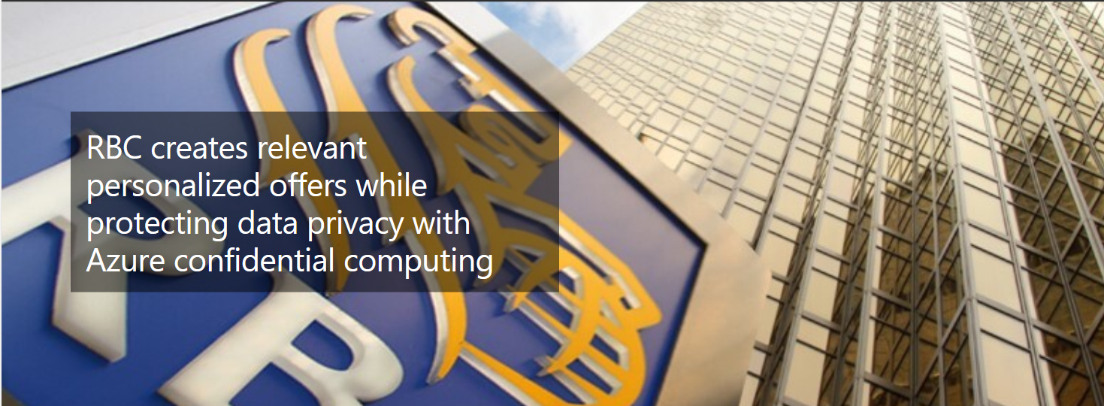
Customer story – RBC (Royal Bank of Canada)
For RBC’s usage of Always Encrypted see: https://aka.ms/rbc-case-study

Slide 19
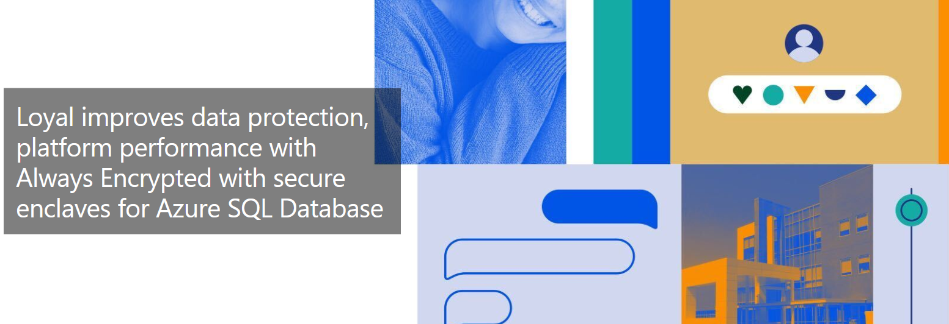
Customer story – Loyal Healthcare
For Loyal’s use of Always Encrypted see: https://aka.ms/loyal-case-study

Slide 20
Always Encrypted vs. Transparent Data Encryption
 | Always Encrypted with secure enclaves | Transparent Data Encryption
SQL Platform Support | SQL Server and Azure SQL Database | SQL Server, Azure SQL Database and Azure SQL Managed Instance
Protects data at rest | Yes | Yes
Protects data in use | Yes | No
Protects data from malicious insiders and cloud operators | Yes | No
Data is encrypted/decrypted on the client side | Yes | No
Encrypt at column level | Yes | No
Transparent to the application | No | Yes
Encryption options | Deterministic Randomized | Server-level – DB-level SMI - CMK
Encryption key management | Customer Managed Keys | Service or Customer Managed Keys
Protects keys in use | Yes | Yes
Driver required | Yes | No

Slide 21
Ledger

Slide 22



Leveraging Ledger in Azure SQL & SQL Server The power of blockchain with the simplicity of SQL
Digital trust is a necessity
How can you establish trust with your customers, partners, or stakeholders?
Distributed blockchains provide a solution, but are complex and expensive to deploy and manage
Ledger – bakes trust
into relational database system
Captures and cryptographically links data changes to make the data tamper-evident and verifiable
Same SQL you already know - high performance and simplicity of relational databases
Use cases
Streamlining compliance audits
Multi-party systems – centralized data, decentralized trust
Notes:
Digital Trust is a necessity in today’s world – it enables customers and businesses to carry out transactions in a way that is secure, and ethical for all parties involved.​
Traditional approach to ensure trust is expensive and inefficient. It involves expensive audits and trusted intermediaries, such as clearing houses.​
Blockchain technologies are promising, but they are complex, introduce completely new programming languages and platforms, offer limited data management capabilities, and poor performance.​
Ledger bakes trust into the RDBMS by adopting crypto technologies, found in distributed blockchains, without bringing their complexities. ​
Ledger cryptographically links the data and the track record of data changes in a blockchain structure, to make the data tamper-evident and verifiable.​
Ledger brings the benefits of blockchains to relational databases, which are much easier and cheaper to deploy and maintain, provide rich data management capabilities, offer much better performance, and are more environmentally friendly, compared to distributed blockchain technologies. Developers can use the tools and the language they are already familiar with. ​
Two primary scenarios for ledger are:​
Streamlining compliance audits. Ledger can provide cryptographic proof of data integrity to auditors, to streamline the auditing process. It also nonrepudiation regarding the integrity of the system's data.​
Multi-party business processes. Blockchain is a great solution for multiple-party networks where trust is low between parties that participate on the network. Many of these networks are fundamentally centralized solutions where trust is important, but a fully decentralized infrastructure is a heavyweight solution. Ledger provides a solution for these networks. Participants can verify the integrity of the centrally housed data, without the complexity and performance implications that network consensus introduces in a blockchain network.​
According to Gartner (Predicts 2019: Blockchain Technologies Published: 5 December 2018 ID: G00374551), “Ninety percent of permissioned blockchain projects are misaligned to blockchain technology, because they remain centralized database projects at the core. These projects can be implemented more quickly, more cost-effectively, and with less risk and higher quality by avoiding blockchain altogether.”

Slide 23

Ledger Tables – Updatable and Append-Only
Updatable ledger tables allow updates and deletes
Updated rows are preserved in the history table
Data is cryptographically protected through the database ledger
Ledger view
Append-only ledger table
Updatable ledger table
History table
Block N
Block N-1
Block N-2
Database ledger
Notes:
Updatable tables are typically the pattern of application.
When you update a particular column in a row, we save the previous row version into the history table. Similar to temporal tables, it’s actually build on temporal.
We also add metadata into the history table like the transactionid, commit timestamp, etc.
The Ledger view gives you a chronical overview of your database. Shows the current value of you record but also the historical values.
Data is protected in what we call the database ledger.
It as Blockchain structure that is implemented in SQL.
Each transaction that the database executes is cryptographically hashed (SHA-256). Transactions are then cryptographically linked together, like a Blockchain.
Cryptographically hashed database digests represent the state of the database.

Slide 24
Ledger Tables – Updatable and Append-Only
Updatable ledger tables allow updates and deletes
Updated rows are preserved in the history table
Data is cryptographically protected through the database ledger
Ledger view
Database digests are uploaded to trusted storage
Updatable ledger table
Append-only ledger table
History table
Database digests are used to verify the database
Append-only ledger tables block UPDATE and DELETE
Block N
Block N-1
Block N-2
Trusted storage
Database ledger
Notes:
Once the block is produced, that root hash representing that block is then pushed outside of SQL.
We push it into a trusted storage location like Azure Immutable blobs or a new service we have Azure Confidential Ledger.
This is where it comes interesting now because an external auditor for example, can run a stored procedure that effectively references that database digest and trusted storage
We recalculate the hashes real-time inside a SQL and either the hashes match or don’t match what was in the digest.
If they don’t match, we know that a tampering event has occurred.
Easy to proof that tampering hasn’t occurred is really powerful.
We also have append-only tables. Very similar except that we block update and deletes.

Slide 25
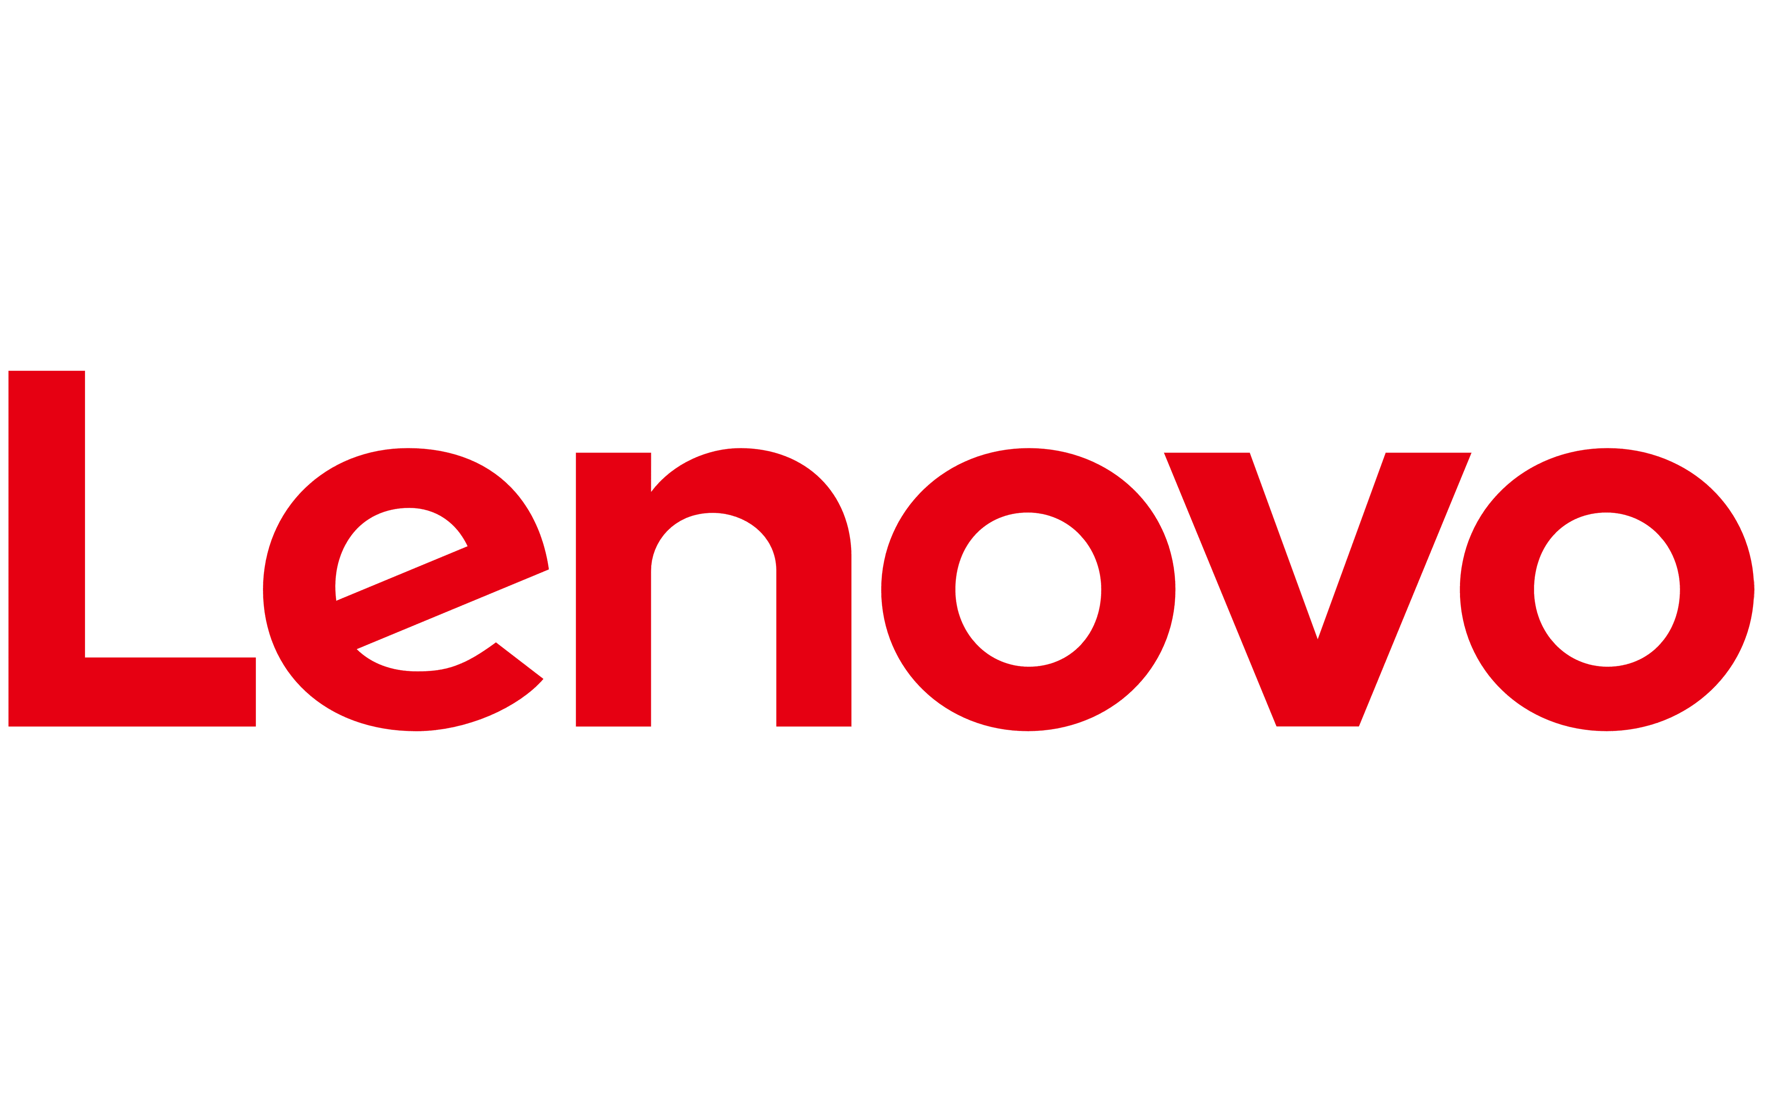
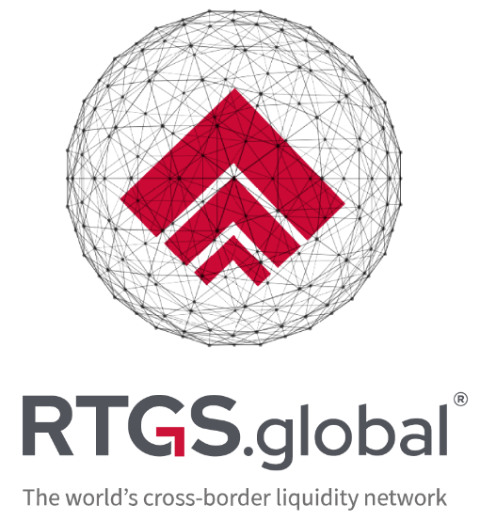

Customers using Azure SQL Database ledger
Azure SQL Database ledger delivers our platform with all of the benefits that blockchain technology provides, without the additional heavy lifting of the blockchain infrastructure, performance considerations and challenges associated with data residency. Working closely with Microsoft on this technology has enabled us to refine our proposition, providing additional benefits to the world’s commercial banks and regulators alike.
Azure SQL Database ledger was perfect for our Trusted Supply Chain solution because it combines high security with great performance, scalability, and better sustainability than blockchain. We’re using ledger to enhance trust in our brand by safeguarding the integrity of our products from the time they leave our manufacturing plant until they’re in our customers’ hands.”
The ledger feature in Azure SQL Database provides us with some of the best features of Azure SQL in terms of database infrastructure management with the integrity verification and auditability of a blockchain. It’s serving our fin-tech and med-tech use-cases well where auditability and integrity checking are of greater importance.
Andrew Smith
Chief Technology Officer
https://aka.ms/rtgs-case-study
Thorsten Stremlau
CTO Commercial Intelligent Devices Group
https://aka.ms/lenovo-case-study
Brendon Kleinhans
Development Departmental Lead
https://aka.ms/qode-case-study
Notes:
These are three customers that are currently moving to production with Ledger in Finance, Supply-Chain and Healthcare.
RTGS - Managed cross-currency transactions between banks and records transactions in ledger tables
Lenovo – stores laptop configuration and specifications in ledger tables to allow customers to verify the integrity of their new laptop and prevent supply chain attacks.
Qode stores medical and audit-related information in ledger tables to easily prove their integrity to auditors and regulators

Slide 26
Demo: Ledger in SQL Server
Notes:
Update a record in updatable ledger table
Tamper with the data
Proof that the data can(not) be trusted

Slide 27

Contoso Clinic
Notes:
Contoso Clinic is using an application called Patient Hub to manage all the patient information, treatments, medications, etc.

Slide 28




Meet…
Betty
Christina
(Patient)
Betty
(Nurse)
Betty
John (DBA)
Michael
(Auditor)
Notes:
In this demo we are going to use 3 different types of users:
Christina , a patient at the hospital
Betty, a nurse at the hospital
Michael, an auditor
Christina just had a surgery on her knee. She’ still laughing on this picture but I can assure you that she is in a lot of pain ☺. The doctor subscribed 4 pain killers per day but Christina thinks this is not sufficient to get her through the day.
She asked the doctor to subscribe an extra doses, but he refused. Christina is desperate and really wants the extra doses.
Her friend Betty is a nurse at the hospital, so he asks her a favor. Betty should access Christina’s patient file and modify the subscription of the pain killers.
They both think that they can modify the data without anyone noticing it. Unfortunately for Betty and Christina, the patient table is an updatable ledger table, which means all changes, along with Betty's identity and the timestamp, have been persisted in a tamper-evident ledger data structures.
Let's assume, a few weeks later, Michael, who is an auditor, performs a routine review of changes in the Patients hub database. As his first step, Michael runs the ledger verification to make sure he can trust the data, he's going to examine. Once the ledger verification is successful, Michael can browse the content of the ledger view for the medications table. He notices a suspicious update operation performed by Betty, who will not be able to effectively deny she has updated Christina’s subscription, because the data in the ledger table has been cryptographically verified as genuine and it clearly shows Betty updated Christina’s subscription.

Slide 29
Wrap-up
Data confidentiality controls
Transparent Database Encryption
Always Encrypted
Data integrity controls
Ledger

Slide 30

Resources Always Encrypted
Blog Post
aka.ms/sqldb-enclaves-blog
Documentation
aka.ms/AlwaysEncryptedEnclavesAzureSQLDB
Tutorial
aka.ms/AlwaysEncryptedEnclavesAzureSQLDBTutorial
Webinar
aka.ms/AlwaysEncryptedEnclavesSQLDBWebinar
Always Encrypted Podcast
The Azure Security Podcast

Slide 31
Resources to learn more
Whitepaper
aka.ms/sql-ledger-whitepaper
Documentation
aka.ms/sqlledger
Lenovo Case Study
aka.ms/lenovo-case-study
RTGS.Global Case Study
aka.ms/rtgs-case-study
Qode Case Study
aka.ms/qode-case-study
Ledger Demo
aka.ms/ledger-demo
Ledger Podcast
aka.ms/ledger-podcast
Ledger Data Exposed
aka.ms/ledger-data-exposed

Slide 32
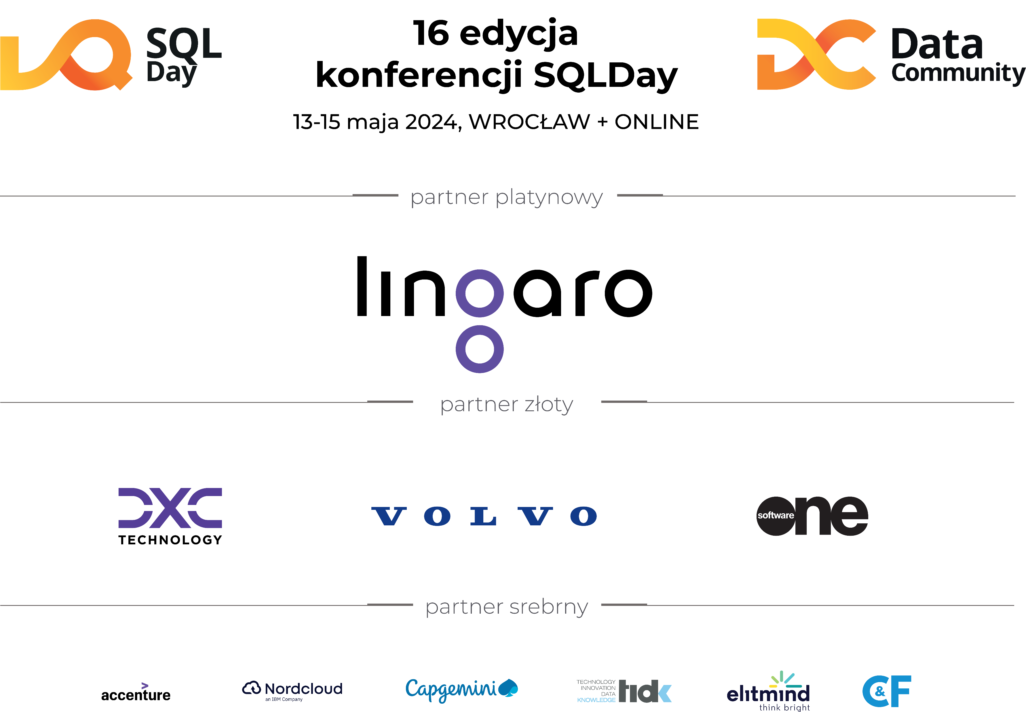

Slide 33
Thank you
Pieter Vanhove
Pieter.Vanhove@microsoft.com

